Slide 1



Unlock Real-Time AI-ML
Event Streaming
with Spring and Cloud Native Data Services

Slide 2

introduction
Gregory Green
Principal Solution Architect
VMware By Broadcom

Slide 3
Goal
What is AI/ML?
Agenda
Technologies Spring & Data Services
Cloud Native Architecture
Conclusion

Slide 4
Goal
How can we understand information to make informed decisions quicker?

Slide 5

Information
Letter message content….

Slide 6
Is this information GOOD or BAD?
Is this Real?
Information
Letter message content….
Is this information dangerous?

Slide 7
Artificial
Intelligence
(AI)
Information
Letter message content….

Slide 8
What is Artificial Intelligence (AI)?
AI is technology that emulates human intelligence

Slide 9
What is Machine Learning (ML)?
ML is artificial intelligence using mathematical data algorithms

Slide 10
AI
AI
Is this information GOOD or BAD?
Sentiment Analysis
Is this Real?
Fraud Detection
Information
Letter message content….
Is this information dangerous?
Threat Detection

Slide 11
Main Idea
AI
AI/ML can help humans to understand information to make informed decisions quicker using Models
ML

Slide 12
What is a Model?
Model is a Machine learning mathematically algorithm that is trained to produce an outcome
Model

Slide 13
Model algorithms are base supervised or unsupervised or reinforcement learning
What are types Model algorithms
Model
<Supervised>
Model
<reinforcement>
Model
<Unsupervised>
neural networks
decision trees
linear regression
hidden Markov
k-means
hierarchical clustering
Gaussian mixture
temporal difference
deep adversarial networks
Q-learning

Slide 14
AI Models Algorithm- categories
Classification
Classification is a ML model algorithm to group data by a category
Anomaly
Clustering is ML model algo algorithm to identify deviation for normal trends
Regression
Regression is ML model algorithm predict outputs
Clustering
Clustering is ML model algorithm to group similar points

Slide 15
Sentiment Analysis
Classification
Classification is a ML model algorithm to group data by a category
Fraud Detection
Information
Threat Detection
Letter message content….

Slide 16
Models are provided training data that is labeled, learned and provided reinforcement feedback predict to future outcome data patterns and trends
How are models trained?
Model
Example Supervised ML Training Data
Text: "I absolutely love this new phone! The camera quality is incredible and the battery lasts all day." Sentiment: Positive
Text: "The movie was so disappointing. The plot was boring and the acting was terrible." Sentiment: Negative
Text: "I had a mixed experience at the restaurant. The food was good, but the service was very slow." Sentiment: Neutral
Text: "This book was an emotional rollercoaster. It had me crying one minute and laughing the next." Sentiment: Positive
Text: "The customer support team was unhelpful and rude. I won't be shopping here again." Sentiment: Negative

Slide 17


Can I use existing models?
Online Platforms like OpenAI with ChatGPT and Hugging Face and others have make is easy to use power AI Model
ChatGPT
<supervised>
Model(s)
FREE!

Slide 18
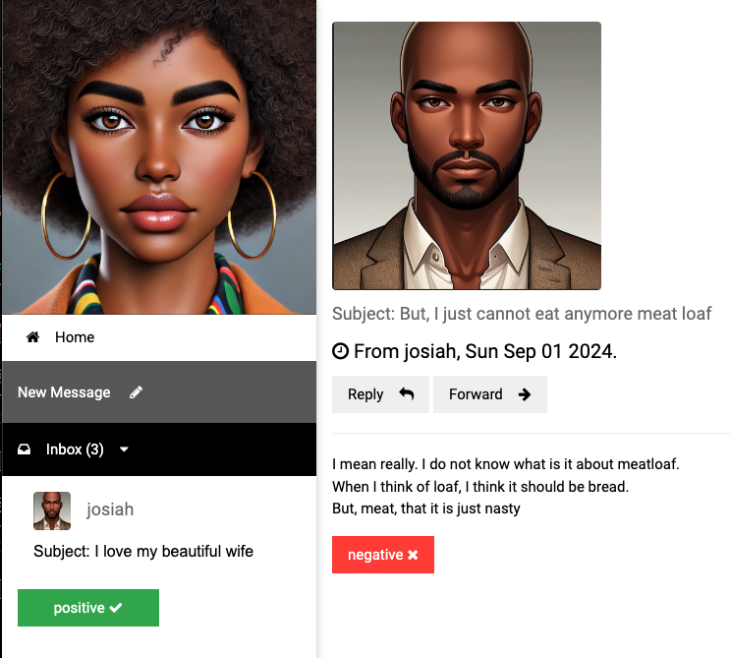
Sentiment Analysis

Slide 19
Getting started with AI/ML
Vector Embedding are a numerical representation of data
App(s)
=>
I love my awesome wife, she is my best friend
[ -0.5539689660072327, -0.04552192986011505, 0.2843276858329773, 0.12018735706806183, -0.4164251685142517, -0.0015744016272947192,
0.8378576636314392, -0.2455213963985443,
0.1919904500246048, 0.3389095067977905, 0.5132707357406616, -0.5949105024337769, -0.05128718167543411, 0.13099819421768188, 0.23817287385463715, 0.16531096398830414, -0.08132422715425491,,… ]

Slide 20
How are vector embeddings generated?
Text Embedding produces vector embedding based on text input
Model
<text-embedding>
App(s)
[ -0.5539689660072327, -0.04552192986011505, 0.2843276858329773, 0.12018735706806183, -0.4164251685142517, -0.0015744016272947192,
0.8378576636314392, -0.2455213963985443,
0.1919904500246048, 0.3389095067977905, 0.5132707357406616, -0.5949105024337769, -0.05128718167543411, 0.13099819421768188, 0.23817287385463715, 0.16531096398830414, -0.08132422715425491,,… ]
I love my awesome wife, she is my best friend
=>

Slide 21
How to perform sentiment analysis?
Model
<text-classification>
Model
<embedding>
App(s)
Text classification determine sentiment such as
VERY_NEGATIVE, NEGATIVE, NEUTRAL, POSITIVE VERY_POSTIVE
Vector embedding
[ -0.5539689660072327, -0.04552192986011505, 0.2843276858329773, 0.12018735706806183, -0.4164251685142517, -0.0015744016272947192,
0.8378576636314392, -0.2455213963985443,
0.1919904500246048, 0.3389095067977905, 0.5132707357406616, -0.5949105024337769, -0.05128718167543411, 0.13099819421768188, 0.23817287385463715, 0.16531096398830414, -0.08132422715425491,,… ]
=>
=>
I love my awesome wife, she is my best friend

Slide 22

How to perform sentiment analysis?
Models
Spring AI
App(s)
Spring AI simplifies the use of ML models such as community libraries like Hugging Face and OpenAI for Java programing applications
I love my wife

Slide 23


How to receive data for sentiment analysis?
Event brokers provides real-time information event streaming
Spring AI
App(s)
Event
Broker

Slide 24


How to store data?
Historical data that is the system of record operational data store
Database

Slide 25

How learn from stored data?
Model
LLM(s)
Vector databases integrate data for Large Language models LLM with similar data as context to provide better outcomes (also known as Retrieval Augmented Generation (RAG).
<Vector>
Database

Slide 26
How to learn from stored data?
Model
LLM(s)
<Vector>
Database

Slide 27

How to get results faster?
Provides fast access In-memory
most frequently used data information
Cache

Slide 28


Models
Models
Consumer Sink App
User
App
Event Processor
App
Data Services
Postgres ML
ValKey
RabbitMQ

Slide 29
Cloud Native Platform
Models
Models
Cloud Native platforms such a Kubernetes and Cloud Foundry simplify the deployment of applications and data service and maintain the health and management
Event Processor
App
Consumer Sink App
User
App
Data Services
Postgres ML
RabbitMQ
ValKey

Slide 30
Conclusion
Goal: How can we understand information to make informed decisions quicker?
AI/ML
Help use understand information based mathematically algorithm models
Spring
Simplifies the use of ML models for Java programing applications for inform outcome based decisions
Cloud Data Services
Event streaming brokers like RabbitMQ provides real-time information, Vector databases like Postgres improve model accuracy and caching services like ValKey provide faster data access

Slide 31

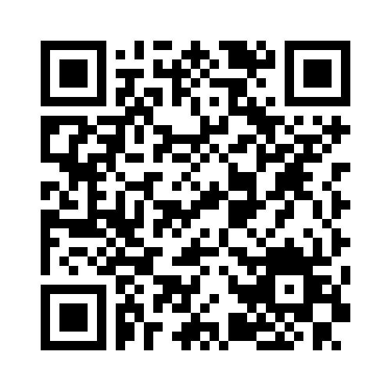
Gregory Green
VMware By Broadcom
Connect with me on
Linked-In
Demo
Source
Code

Slide 32

Cache
Event
Broker
Web App
Database

Slide 33
Why
Understand information better
Making decision fast

Slide 34
Generative
vs
Traditional
AI

Slide 36
VIDEO WILL BE HANDLED BY THE AV TEAMS AND NOT EMBEDDED INTO DECK.
PLEASE SEND DOWNLOAD LINK (NOT ACTUAL VIDEO FILE) TO ATC-TALENT@BLAVITY.COM
VIDEO HERE

Slide 38
Based on this definition, when was the last time you were innovative?

Slide 39
Section Break

Slide 40
Section Break

Slide 41

Add your a question?

Slide 42
Add your a question?

Slide 43
Title of Slide

Slide 44
“Here’s space for a good pull quote to discuss”
First Last, Title

Slide 45
“Here’s space for a good pull quote to discuss”
First Last, Title

Slide 46
Title of Slide
Main Idea One
Data is the first and best way to back-up a solutioning hypothesis and/or prove a hunch in the long run
Main Idea One
Data is the first and best way to back-up a solutioning hypothesis and/or prove a hunch in the long run
Main Idea One
Data is the first and best way to back-up a solutioning hypothesis and/or prove a hunch in the long run
Main Idea One
Data is the first and best way to back-up a solutioning hypothesis and/or prove a hunch in the long run

Slide 47
Title of Slide
Main Idea One
Data is the first and best way to back-up a solutioning hypothesis and/or prove a hunch in the long run
Main Idea One
Data is the first and best way to back-up a solutioning hypothesis and/or prove a hunch in the long run
Main Idea One
Data is the first and best way to back-up a solutioning hypothesis and/or prove a hunch in the long run
Main Idea One
Data is the first and best way to back-up a solutioning hypothesis and/or prove a hunch in the long run

Slide 48
Main Idea One
Main
Idea Goes Here
The state in which every person, regardless of human difference, can access and harness the full power of digital products, without bias, harm or limitation.

Slide 49
Main Idea One
Main
Idea Goes Here
The state in which every person, regardless of human difference, can access and harness the full power of digital products, without bias, harm or limitation.

Slide 50
The state in which every person, regardless of human difference, can access and harness the full power of digital products, without bias, harm or limitation.
Exercise 1

Slide 51
The state in which every person, regardless of human difference, can access and harness the full power of digital products, without bias, harm or limitation.
Exercise 2

Slide 52
Have you asked yourself this question?
This is a block of text that helps add context to the big impactful statement above.

Slide 53
Have you asked yourself this question?
This is a block of text that helps add context to the big impactful statement above.

